Slide 1
A Place Called Home
Christine Anna Rumawas
https://annalogy.info

Slide 2



Tak Kenal Maka Tak Sayang
!(knowpersonally) == !(love)

Slide 3
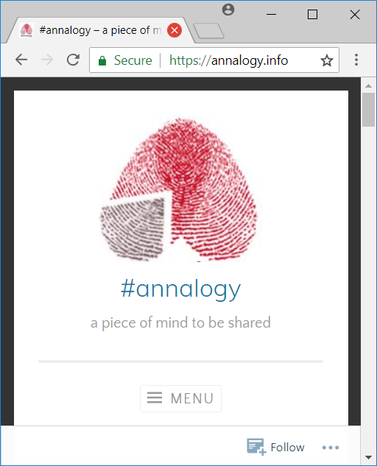
Tak Kenal Maka Tak Sayang
!(know-personally) == !(love)
https://annalogy.info/

Slide 4


Who Are You?

Slide 5
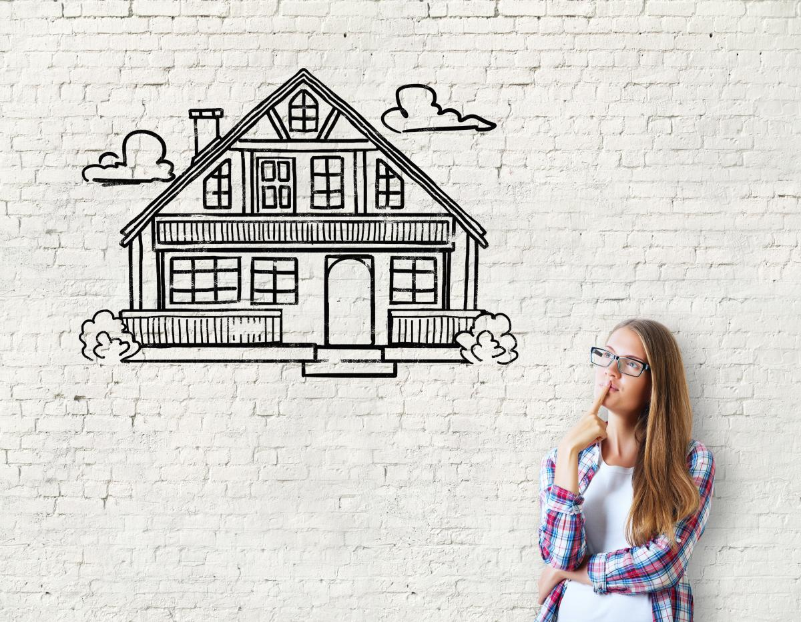
House VS Home
Is this a house or a home?

Slide 6
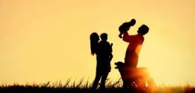

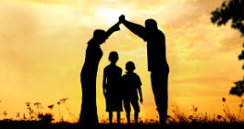
What Is A Home?

Slide 7

Why Do You Need A Home?

Slide 8

Why Do You Need A Home?

Slide 9

Why Do You Need A Home?
Insecurity

Slide 10
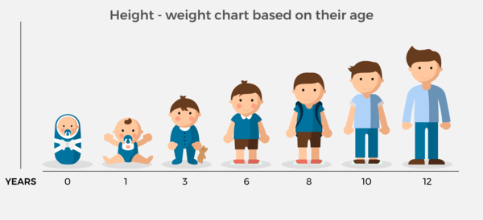
Why Do You Need A Home?

Slide 11

Why Do You Need A Home?

Slide 12

How We Build A Home?
Community
Of
Practice

Slide 13
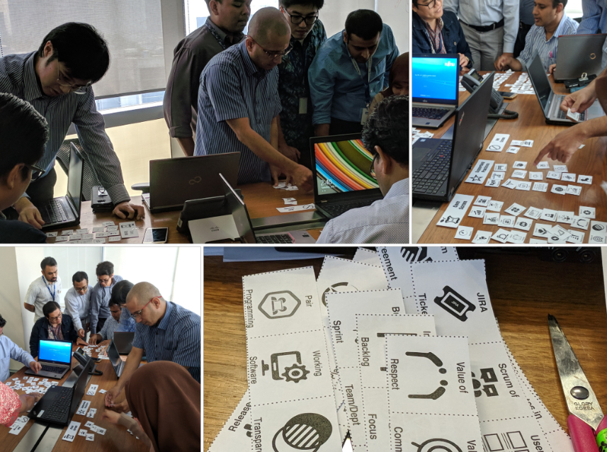
How We Build A Home?
Rejuvenate
Scrum
Practices

Slide 14
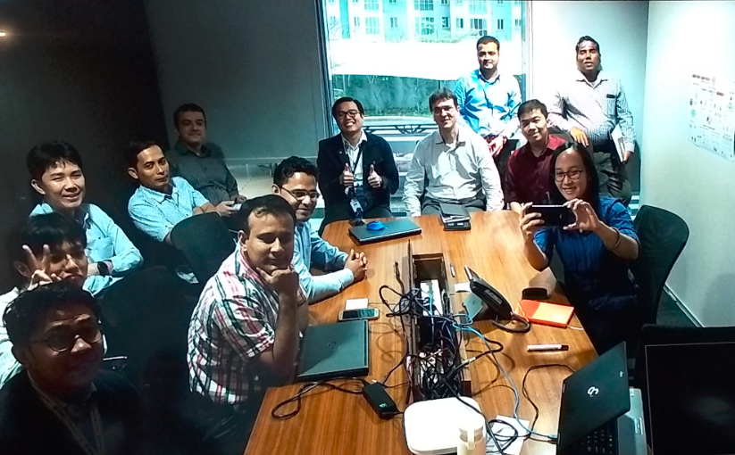
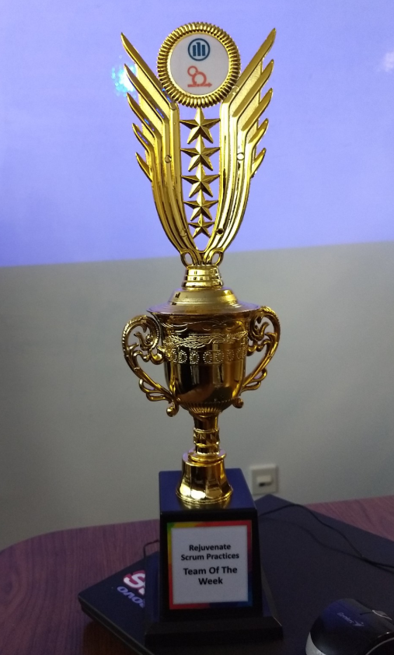
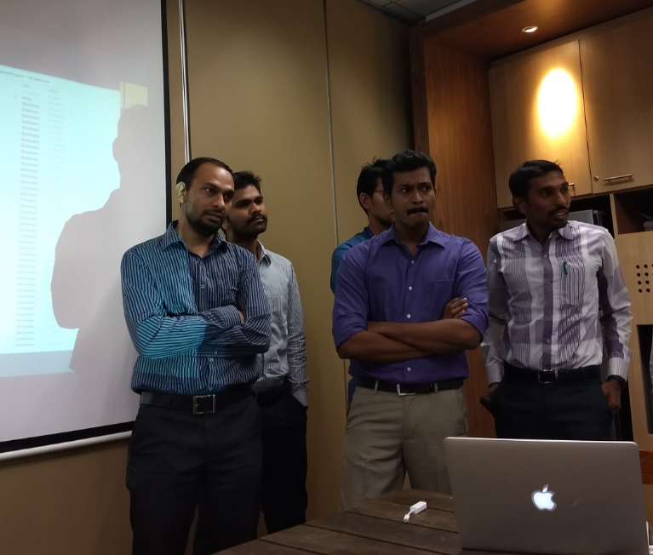
How We Build A Home?
Rejuvenate
Scrum
Practices

Slide 15
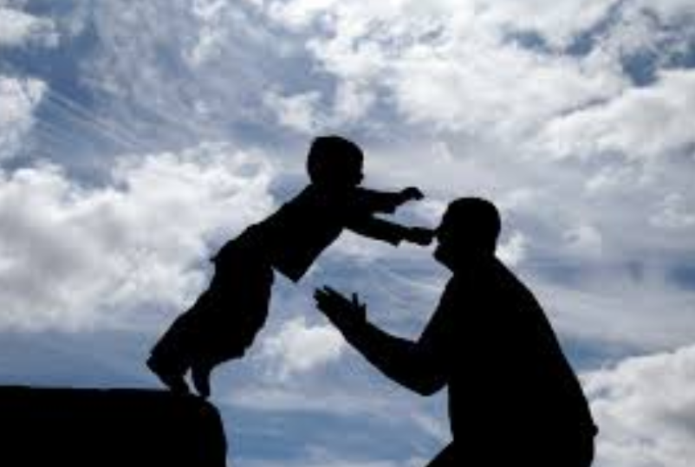
How We Build A Home?
TRUST

Slide 16

How We Build A Home?

Slide 17

Challenge
Cynical
Is this really works?
You guys know what you’re doing?
This is a waste of time
etc

Slide 18
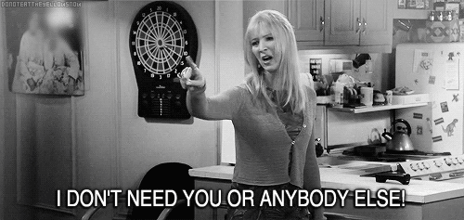
Challenge
We’re good

Slide 19

Challenge
Prefer to Stand Outside

Slide 20

Challenge
Management Challenge

Slide 21
CHALLENGE is only a CHANGE
with LLE as the additional

Slide 22
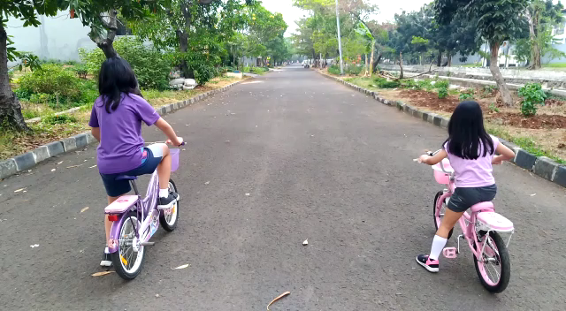
Analogy

Slide 23


